Slide 1
Deep Learning for Lip Reading Final Year Screencast by Jack Pay Project Supervisor: Terence Morley
Notes:
Name
Supervisor name
Terence Morely
Recording screencast for my project
Using deep learning for lip reading

Slide 2
Coming Up
Background
Results
Demonstration
Conclusion
Notes:
First:
Want to go over the sections in the presentation

Slide 3
Up Next: Background
Background
Aims
Motivation
MediaPipe
Results
Demonstration
Conclusion
Notes:
Within the next section:
Look at the aims & objectives
Motivation behind the project
Look into how we can realise this more

Slide 4
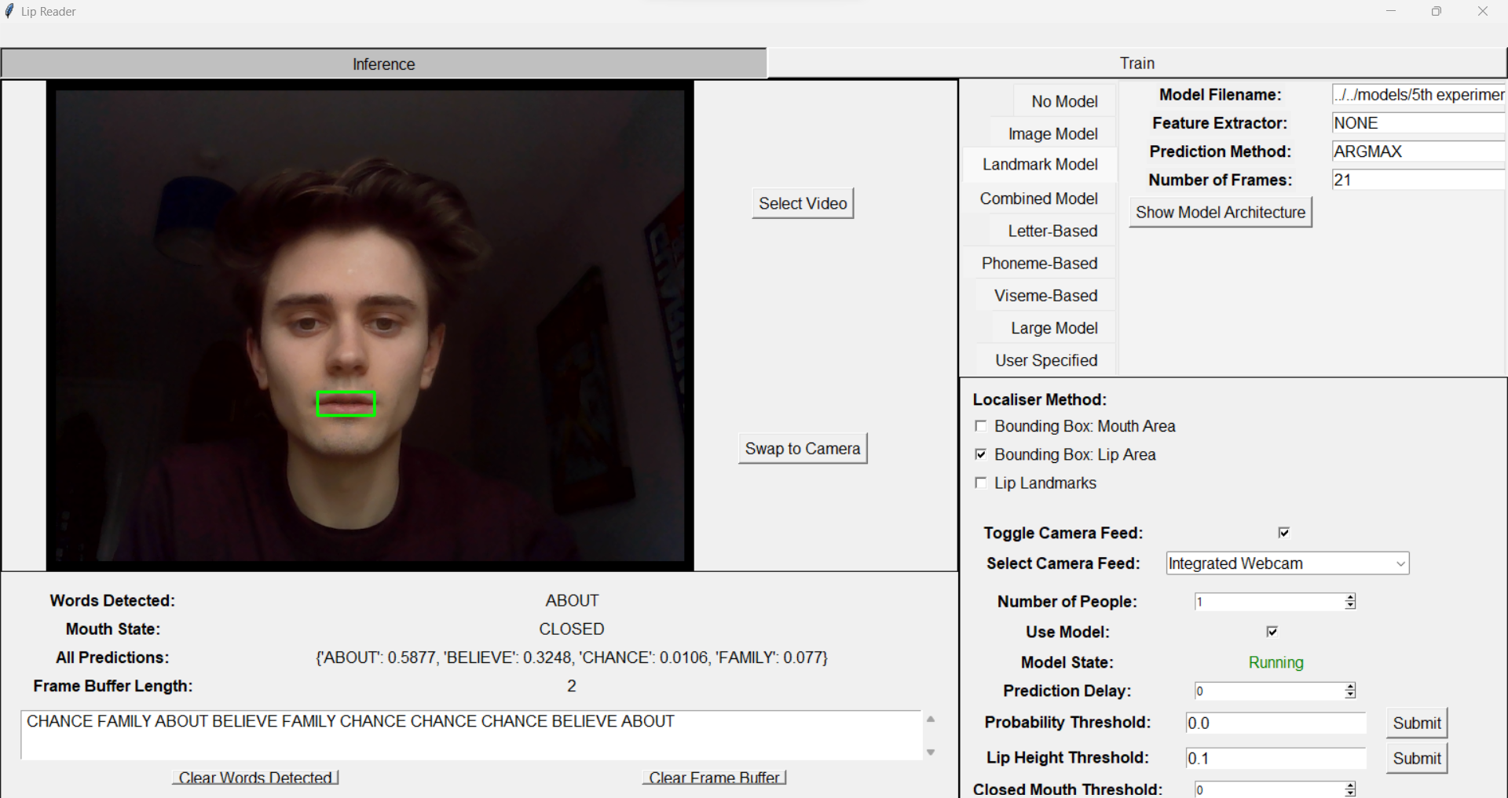
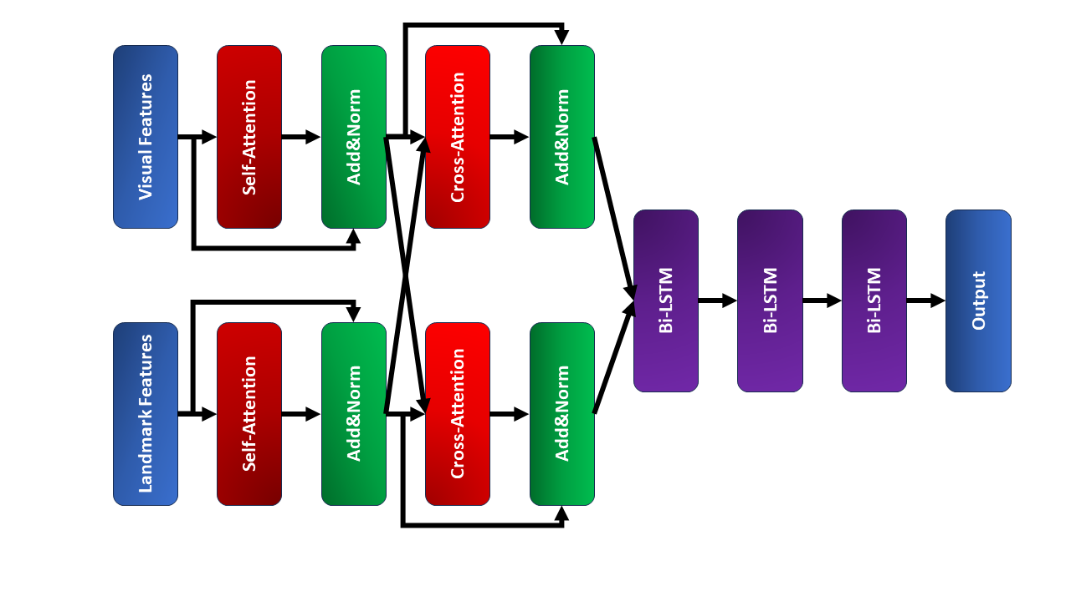
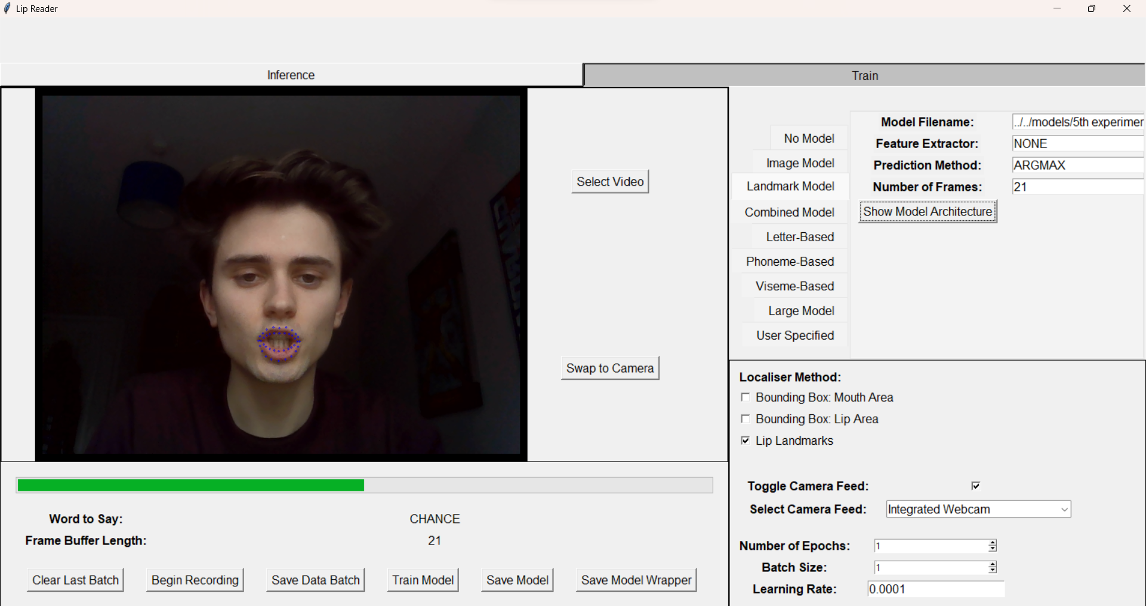
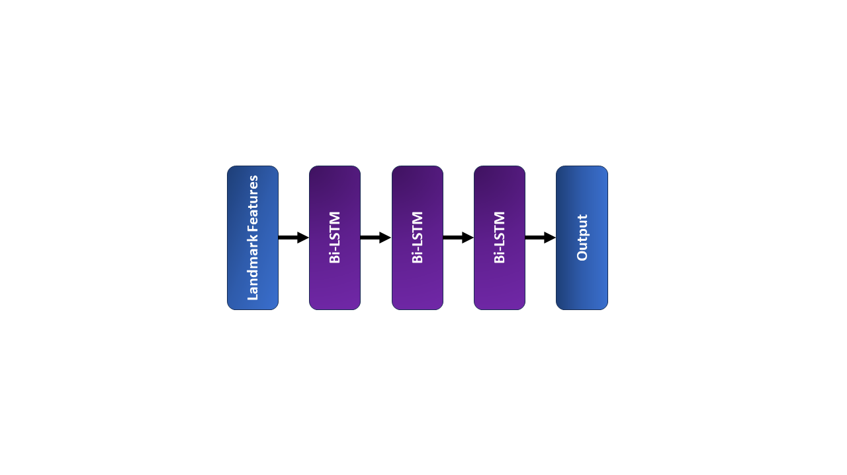
Aims
Create & compare models for lip reading
Find the best architecture for lip reading
Create a GUI
Notes:
I had 3 main aims:
Analyze different models for lip reading
Experimented with various structures and techniques to make the best possible model
Best architecture
Wanted to find which architecture works the best
Wanted to optimize this architecture & find the hyperparameters that work best
What are hyperparameters?

Slide 5
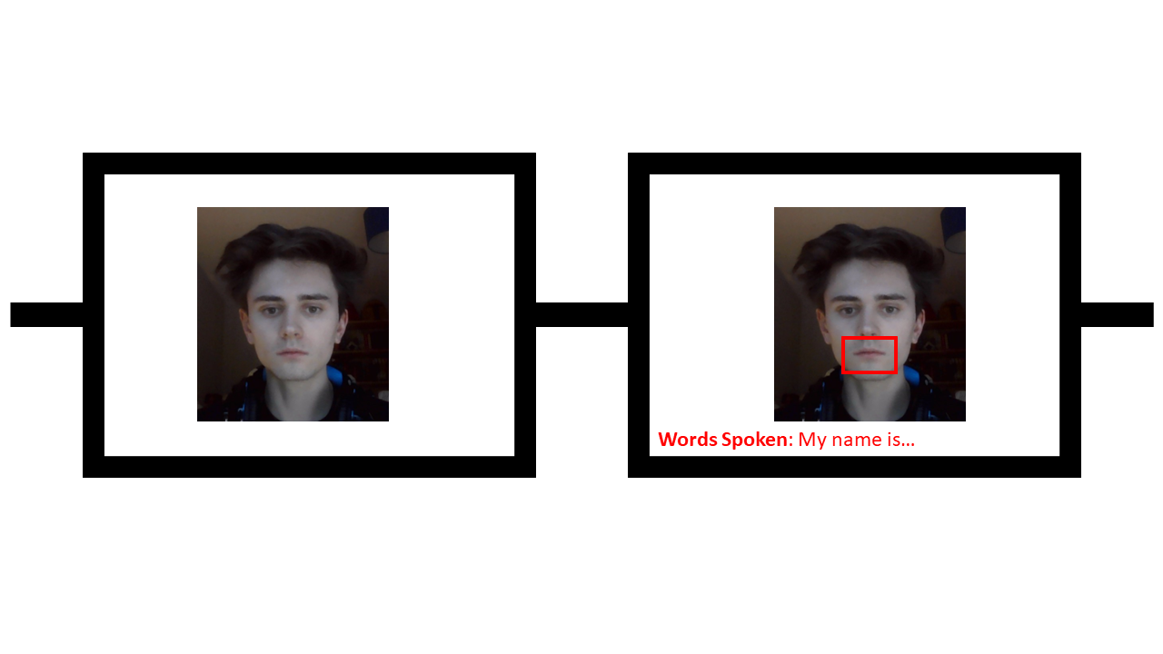
Motivation
How important is lip reading?
How does this affect me?
What about hearing aids?
Deafness if the fourth leading disability globally [1]
Deafness is on the rise [2]
Everyone uses lip reading
Numerous applications!
Law enforcement
Enhance closed caption generation
New hearing aid?
[1] L. L. Cunningham and D. L. Tucci. Hearing loss in adults. New England Journal of Medicine, 377(25):2465–2473, 2017. PMID: 29262274
[2] World Health Organization. Deafness and hearing loss, 2023
Notes:
“Modern hearing aids and cochlear implants are quite invasive. What if we could instead create a pair of glasses, like the ones shown here, that could, in real time, focus on a person and read their lips, transcribing exactly what is being said to a deaf person?”

Slide 6
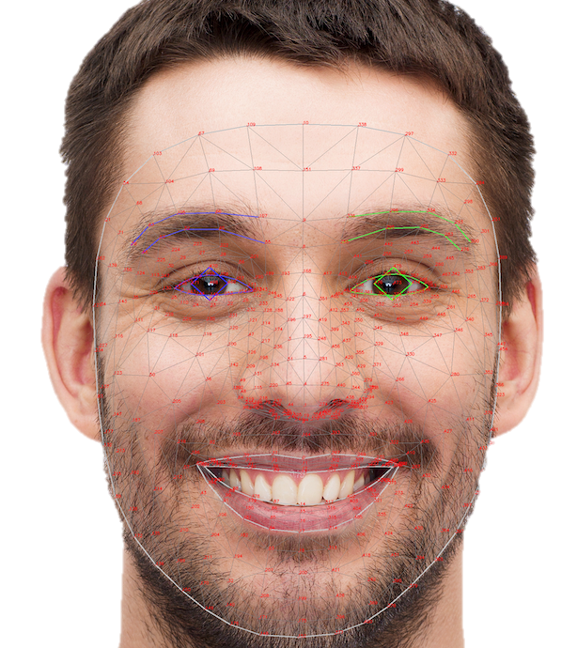
MediaPipe
Machine Learning framework developed by Google
Provides various functionality:
Gesture tracking
Object classification
Etc
Notable tool:
Face Landmark Detection
478 facial landmarks
40 lip landmarks
Upper & lower lip
Inner & outer lip
https://developers.google.com/mediapipe/solutions/vision/face_landmarker
https://developers.google.com/mediapipe
Notes:
Framework developed by Google
Provides lots of different tools:
Gesture recognition
Audio processing
The useful one: facial landmark detection
What is this?
Detecting human faces within images & identifying key parts of the face
Draw landmarks on the face: eyes, lips, nose, etc

Slide 7
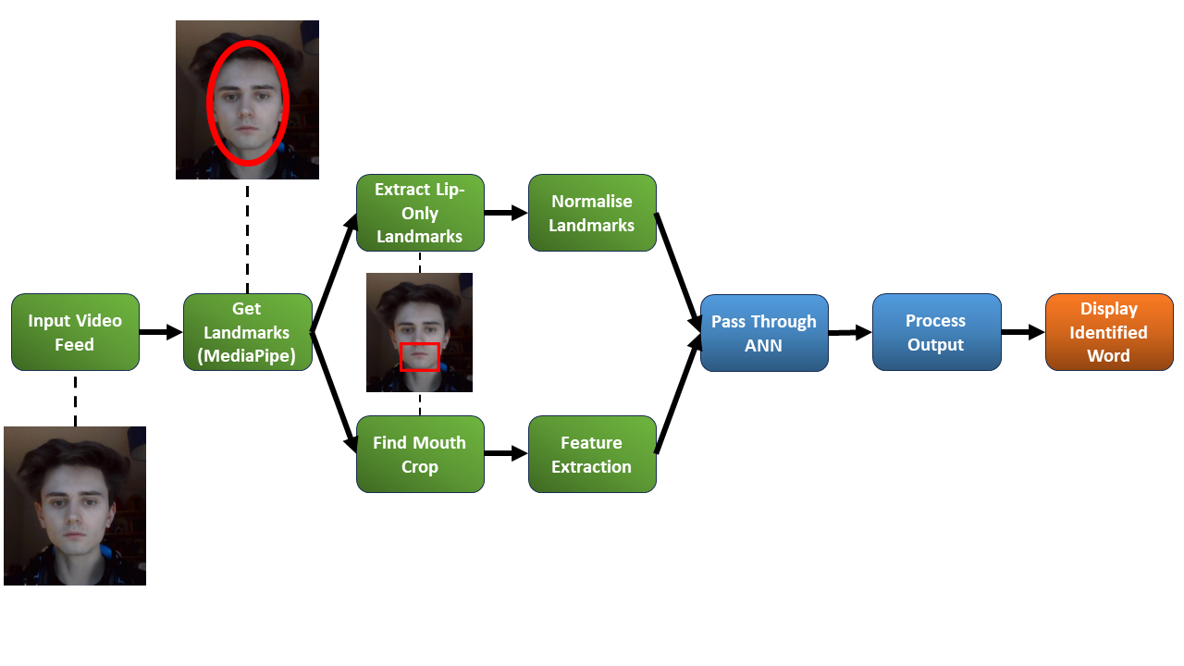
How can we Use Mediapipe?

Slide 8
Up Next: Results
Background
Results
Best Models
CTC Deep Dive
Demonstration
Conclusion
Notes:
Within the next section:
Look at the aims & objectives
Motivation behind the project
Look into how we can realise this more

Slide 9
Results
Experiment | Summary | Accuracy | Loss | WER
4.2 (Image) | Input: Images Arch: Bi-LSTM Output: Words | 0.9670 | 0.3953 | 0.0330
5.4 (Landmark) | Input: Landmarks Arch: Bi-LSTM Output: Words | 0.9704 | 0.0949 | 0.0296
8 (Transformer) | Input: Landmarks Arch: Transformer Output: Words | 0.9203 | 0.2730 | 0.0797
9.1 (Letter) | Input: Combined Arch: Transformer Output: Letters | 0.9076 | 2.6221 | 0.2187
9.2 (Phoneme) | Input: Combined Arch: Transformer Output: Phonemes | 0.7412 | 1.9542 | 0.2107
9.3 (Viseme) | Input: Combined Arch: Transformer Output: Visemes | 0.8068 | 1.7748 | 0.1765
Cross Entropy Loss
CTC Loss
Notes:
In total we did 17 experiments
Tried different architectures, optimized these
Tried data augmentation, dropout, etc
Here we have the best 6 models recorded
First two are a Bi-LSTM architectures
One used images as input whilst the other used landmarks
Next we had a Transformer
Next three experiments used different loss metric:
This is what we’re going to go into next

Slide 10
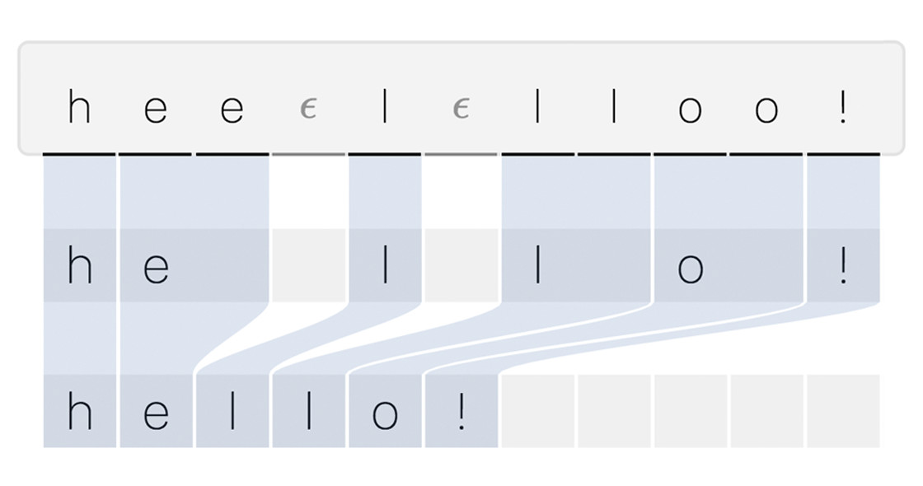
What is CTC loss?
Connectionist Temporal Classification Loss
Good for our application:
Learns connections between two sequences
First sequence: Video
Frames or landmarks
Second sequence: What’s being said
Words
Letters
Phonemes
Visemes
Notes:
CTC stands for Connectionist temporal classification loss
What is this?
CTC is fantastic for finding mappings between two different sequences
Where we don’t know the exact mapping
With many videos we have exact frames where we know what is happening
This isn’t really the case for lip reading (or it’s hard to do)
CTC suits lip reading:
We can use this to find the alignment between our 2 sequences
Between frames of a video and the words being said
Explain the example

Slide 11
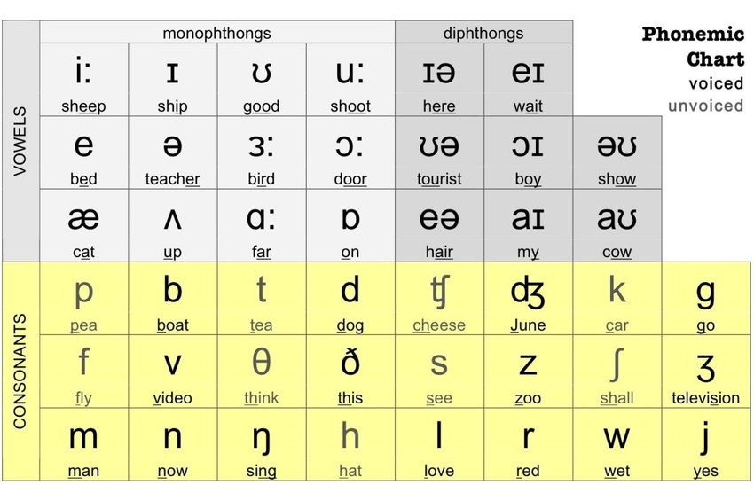
Phonemes & Visemes?
Phonemes:
The fundamental & distinct sounds that are made during speech
Used to distinguish words
Eg. “B” “P”
Viseme:
The visual counterparts to phonemes, the speech sounds that form similar lip shapes
Eg. ‘B’ & ‘P’ both have the ‘p’ viseme
https://www.researchgate.net/figure/English-Phonemic-Chart_fig1_358228103
Notes:
Phonemes:
Explain
Visemes:
Explain
More closely related to lip reading: it is a visual-only medium

Slide 12
CTC Comparison
Directly comparable results
Same data split
Same architecture
Focus:
Loss & WER
Viseme performs the best
This makes sense
Experiment | Accuracy | Loss | WER
Letter (9.1) | 0.9076 | 2.6221 | 0.2187
Phoneme (9.2) | 0.7412 | 1.9542 | 0.2107
Viseme (9.3) | 0.8068 | 1.7748 | 0.1765
Experiment | Accuracy | Loss | WER
Letter (9.1) | 0.9076 | 2.6221 | 0.2187
Phoneme (9.2) | 0.7412 | 1.9542 | 0.2107
Viseme (9.3) | 0.8068 | 1.7748 | 0.1765
Notes:
“Now that that’s out of the way, let’s look back at our results. For experiment 9 I wanted directly comparable results and therefore I kept the same data split & architecture, varying only the classes of my training data. My classes are my independent variable. Here we are going to focus primarily on loss and Word Error rate. This is because these are more important, especially the latter. Now we see that these results make perfect sense. Of course Visemes perform the best, better than phonemes and letters. This is because they are more closely related to the visual-only data that we are using.”

Slide 13
Up Next: Demonstration
Background
Results
Demonstration
Inference Demo
Fine-tuning
Our New Model
Conclusion
Notes:
Within the next section:
Look at the aims & objectives
Motivation behind the project
Look into how we can realise this more

Slide 14
Inference DEmo
Notes:
Now that we’ve seen a model in action, let’s analyse the result

Slide 15
Let’s Analyse
?
?
CHANCE
BELIEVE
?
Some words were correct
“ABOUT”, “CHANCE”, “FAMILY”
Other words the model struggled with
“BELIEVE”
What are the reasons for this?
Data: LRW (Lip Reading in the Wild)
Accent
Distance to the camera
Context?
What can we do?
FAMILY
ABOUT
?
?
https://www.robots.ox.ac.uk/~vgg/data/lip_reading/lrw1.html
Notes:
“Our models performed really well on some words, for example Chance, but others it really struggled with. There are many potential reasons for this but the most likely is the data.”
“Now we trained the models upon a dataset called LRW or Lip Reading in the Wild. This is made up of BBC broadcasts. Therefore our training data is quite different to the input data we are using here, in terms of accent, distance to the camera but more importantly context. BBC broadcasts are made up of full sentence utterances whereas I am testing with standalone words. Furthermore, I know my lips are being read which makes a surprisingly large difference. But what can we do about this?”

Slide 16
Fine-tuning
Fine-tuning:
A model is trained a second time on a different task
Allows the transfer of knowledge
We get a model specialized for the task
This a feature of the GUI
We can record more data
We can make a better model

Slide 17
Inference Demo (Again)
Notes:
“There we have it: our finetuned lip reading model that now performs with far higher accuracy than before. And with it we come to the end of this screencast. Overall throughout this research there were several major findings. Using CTC loss lead to my most important finding: that visemes are the best classes for lip reading, followed by phonemes and then letters. Next we found that transformers are good for lip reading but bidirectional LSTMs are even better. Finally I also discovered the benefits of finetuning lip reading models: greatly increasing the performance of our lip reading models. Thank you for listening.”

Slide 18
Conclusion
Major Findings:
Visemes performs better than letter & phoneme prediction
Transformers are good
Bi-LSTM is the best
Fine-tuning is great
Notes:
“There we have it: our finetuned lip reading model that now performs with far higher accuracy than before. And with it we come to the end of this screencast. Overall throughout this research there were several major findings. Using CTC loss lead to my most important finding: that visemes are the best classes for lip reading, followed by phonemes and then letters. Next we found that transformers are good for lip reading but bidirectional LSTMs are even better. Finally I also discovered the benefits of finetuning: greatly increasing the performance of our lip reading models. Thank you for listening.”

